Slide 1
DIP PRESENTATION BSCS 6TH
JAHANZAIB Babar 2019-ag-6055
MUHAMMAD Zain 2019-ag-6079

Slide 2
IMAGE NEGATIVE
A negative of an image is an image where its lightest areas appears as darkest and the darkest areas appear as lightest.

Slide 3
IMAGE NEGATIVE
The appearance change from lightest to darkest and darkest to lightest is basically done in gray scale image and refers to the change of pixel intensity values from highest to lowest and lowest to highest.

Slide 4
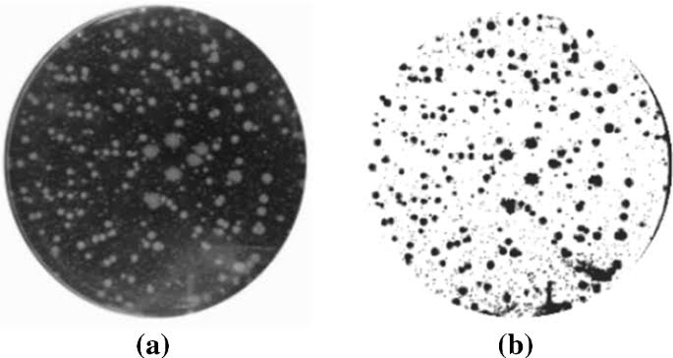
NEGATIVE OF GRAYSCALE IMAGE

Slide 5
IMAGE NEGATIVE
The negative of an image is achieved by replacing the intensity ‘i’ in the original image by ‘i-1’, i.e. the darkest pixels will become the brightest and the brightest pixels will become the darkest.

Slide 6
IMAGE NEGATIVE
Image negative is produced by subtracting each pixel from the maximum intensity value.

Slide 7
Example
In an 8-bit grayscale image, the max intensity value is 255, thus each pixel is subtracted from 255 to produce the output image.

Slide 8
IMAGE NEGATIVE
In case of color image, different color is represented as negative of different colors according to their intensity values.

Slide 9
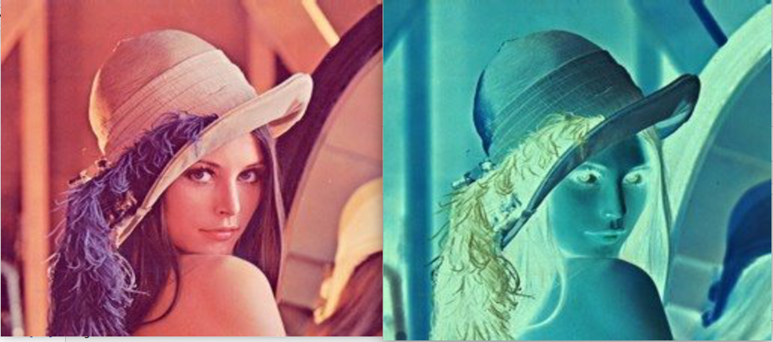
NEGATIVE OF COLOR IMAGE

Slide 10
TRANSFORMATION FUNCTION
The transformation function used in image negative is:
s = T( r ) = (L – 1) – r
WHERE L - 1 is the max intensity value,
s is the output pixel value and
r is the input pixel value

Slide 11
ALGORITHM
Read RGB color image into the MATLAB environment using MATLAB inbuilt function imread()

Slide 12
ALGORITHM
Calculate the levels of the image, for example an 8-bit image has 256 levels

Slide 13
ALGORITHM
Use the formula stated below on every pixel of the image to get corresponding negative pixel value.
s = T( r ) = (L – 1) – r

Slide 14
ALGORITHM
Convert each RGB pixel value at location (i,j) to its negative image values and assign it to the corresponding location (i,j) of another matrix.

Slide 15
ALGORITHM
Display the negative image using MATLAB in-built imshow() function.

Slide 16
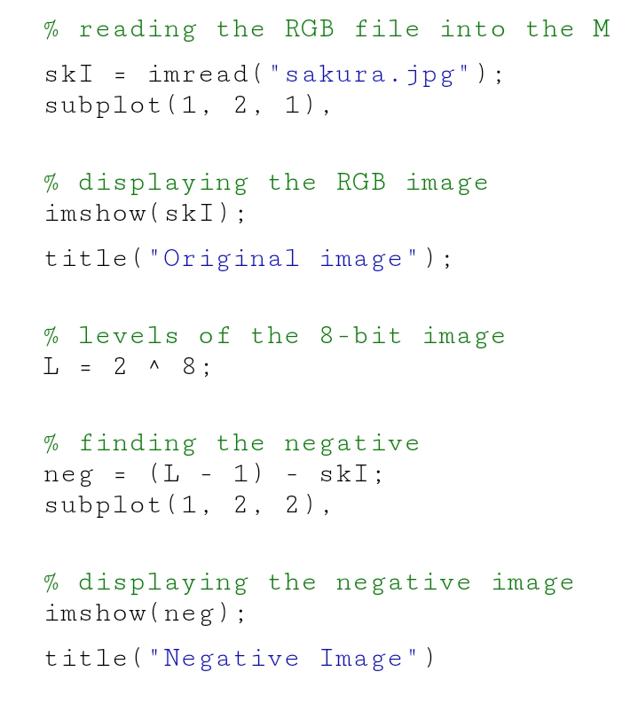
ALGORITHM

Slide 17
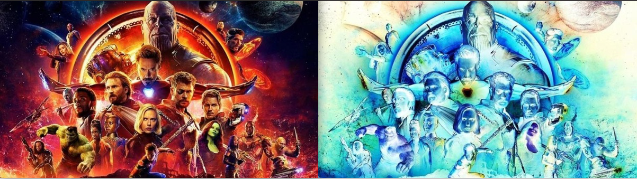
OUTPUT

